Slide 1
3D Laser Range Finder
Group 27
Christian Conrose, Andrew Watson, Jon Ulrich
Notes:
Add picture

Slide 2
LIDAR
LIght Detection And Ranging

Slide 3
Motivation
AUVSI Competitions for Robotics Club
Augment Computer Vision Capabilities
Mobile 3D range finder
Visually represent range data
Notes:
Over the many years of intense competition with a variety of platforms across multiple teams the Robotics Club at UCF has consistently found a need for collecting highly accurate 3D data from the environment. To completely and reliably map a real-world environment however one must consider all dimensions at once to fully construct a true representation. The club has generously offered to donate a fast, long range 2D laser range finder to help in the construction of the proposed system.

Slide 4
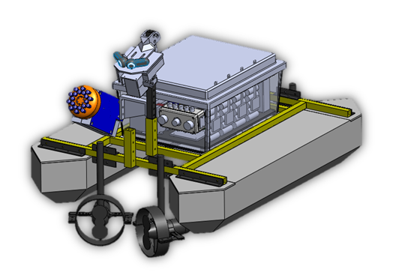
Goals
Create Accuracte 3D Sensor
Indoor/Outdoor Operation
High Update Rate
Longevity
Occams Razor

Slide 5
Specifications Requirements
Size | Less than 3 cubic feet
Weight | Less than 5 pounds
Power Draw | Less than 36 watts
3D Scan Rate | 2 hertz
Communication Port | Ethernet
Weather Rating | IP45
Notes:
Boat photo

Slide 6
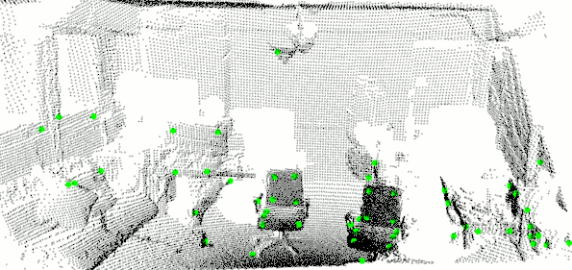
Process
Rotating 2D lidar sensor
Event driven system
Rotation adds 3rd dimension

Slide 7
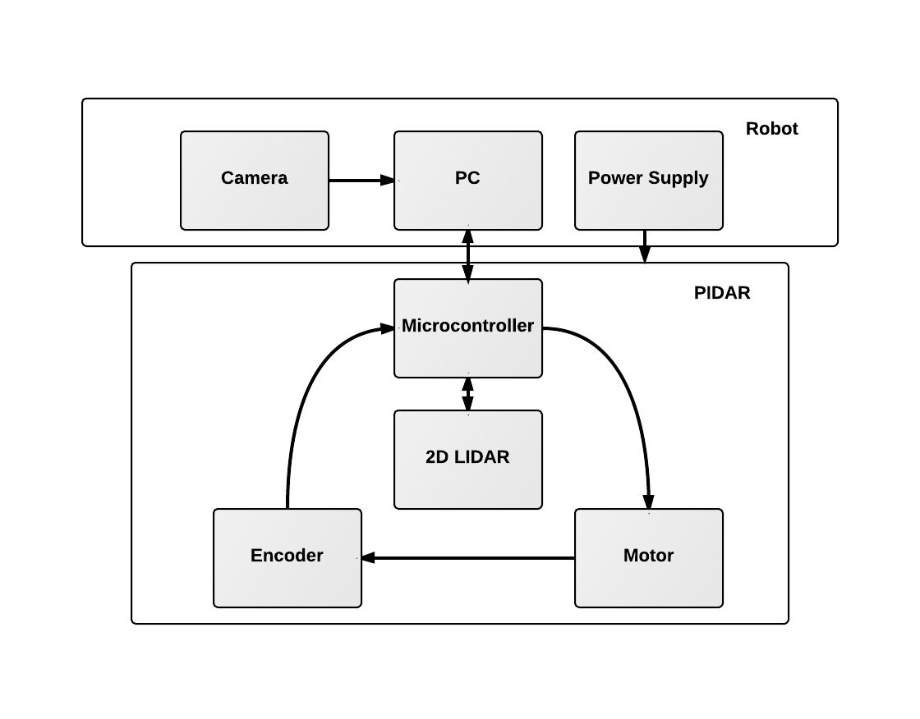

Slide 8
Lidar Selection
 | Hokuyo PBS | SICK LMS291-S05 | Hokuyo UTM-30LX
Light Source | IR LED | Laser Diode | Laser Diode
Application | Indoor | Indoor / Outdoor | Indoor / Outdoor
Angular Resolution | 1.8 | 0.25 | 0.25
Scanning Range | 178 | 180 | 270
Detecting Range | 0.2m to 3m | 1.5 - 30m | 0.1m to 30m
Scan Time | 100ms | 75ms | 25ms
Power | 24VDC | 230V | 12VDC
Price | $1,200 | $3,500 | $6,000

Slide 9
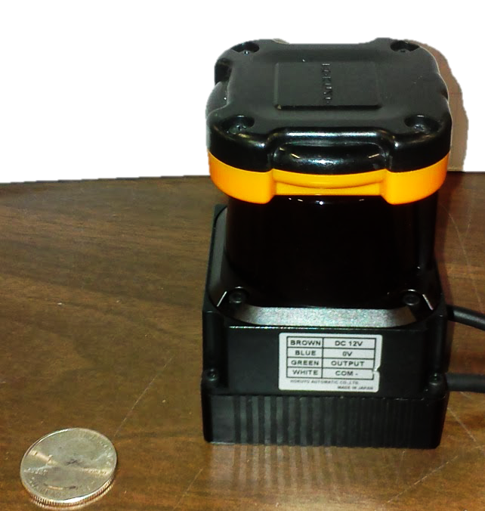
Laser UTM-30LX
30 meter range
Serial Interface
C++ Library
Scan Feedback

Slide 10
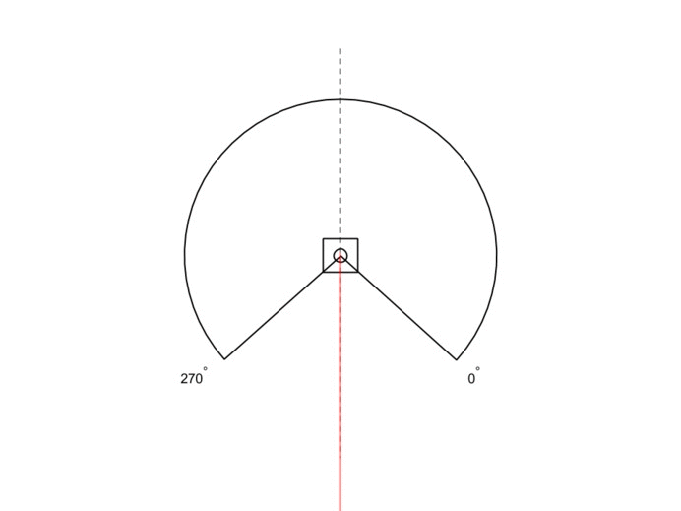
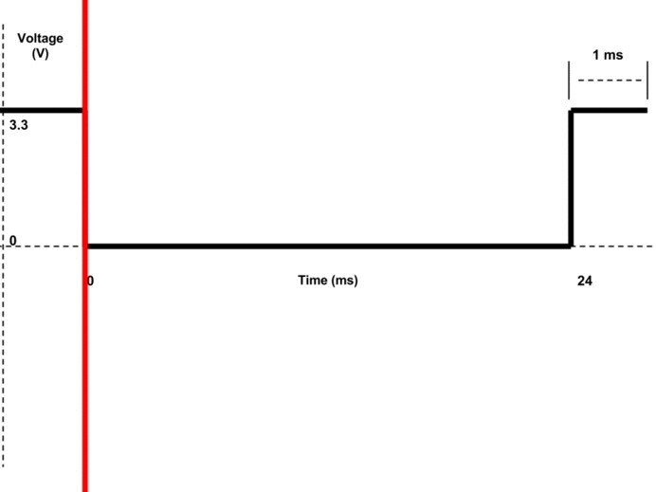
Event
Driven

Slide 11
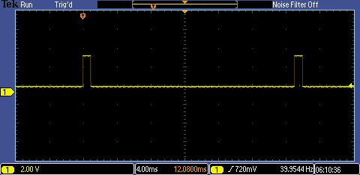
Laser

Slide 12
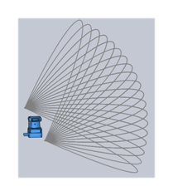
Motion: Pitch
+Pro:
Immediate Horizon
-Con:
Alternating Directions
Full Scan Latency

Slide 13
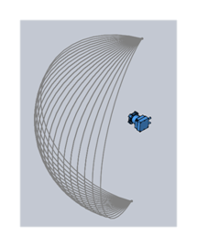
Motion: Yawing Scan
+Pro:
Immediate
Vertical Scan
-Con:
Alternating
Directions
Full Scan
Latency

Slide 14
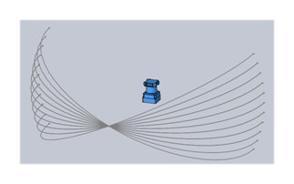
Motion: Rolling Scan
+Pro:
Center Focus
Continuous
Rotation
-Con:
Peripheral Vision

Slide 15
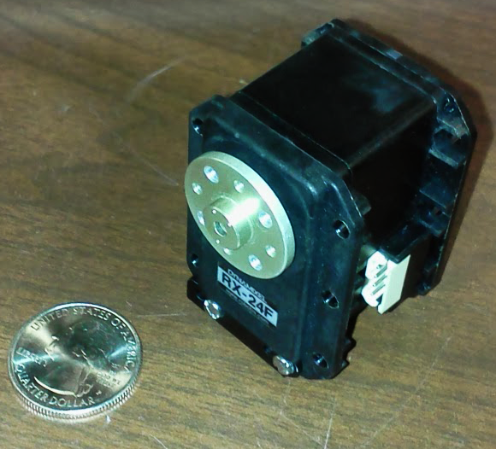
Motor Selection
 | Dynamixel RX-24F | 42BYGHM809 | Dynamixel MX-28
Motor Type | Servo | Stepper | Servo
Resolution | 0.29 | 0.9 | 0.088
Voltage | 12VDC | 3VDC | 12VDC
Price | $139 | $17 | $219

Slide 16
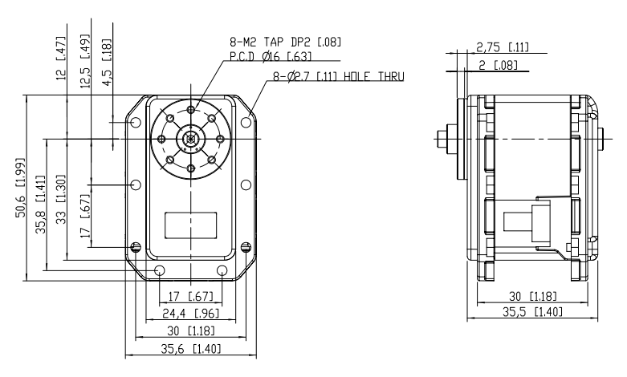
Motor Selection: MX-28T
Motor Feedback
Highest Resolution
Continuous Rotation
Serial Communication
12V Rail

Slide 17
3D Interpolation
Input Output
2D Point 3D Point
Motor Position

Slide 18
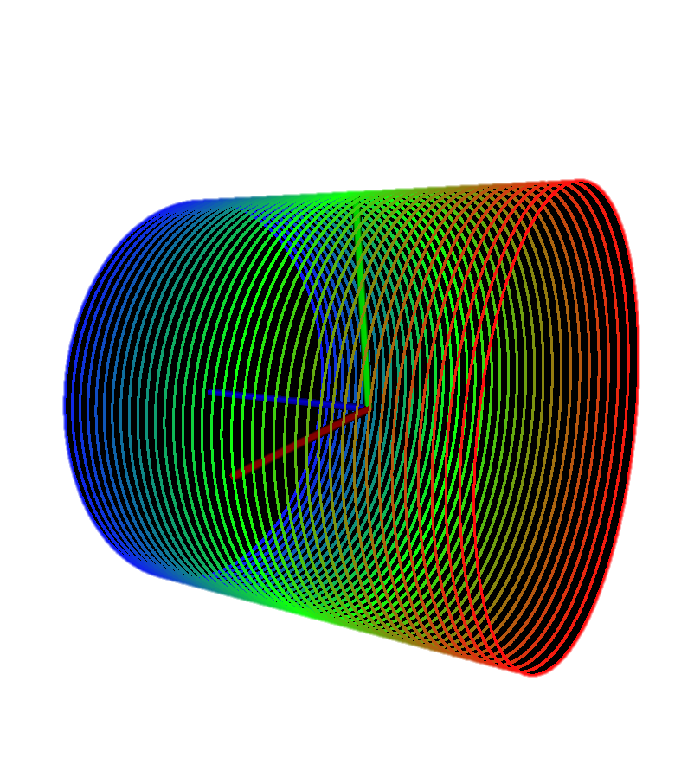
Point Cloud
Visualization

Slide 19
Microcontroller
 | Raspberry Pi Model B | Beagle Board Black | Pandaboard ES
Price | $35 | $45 | $182
Processor | 700MHz | 1GHz | 1.2GHz Dual Core
RAM | 512MB | 512MB | 1GB
Size | 3.37” x 2.125” | 3.4” x 2.1” | 4.5” x 4”
Max. Drain | 700mA | 470mA | 800mA

Slide 20
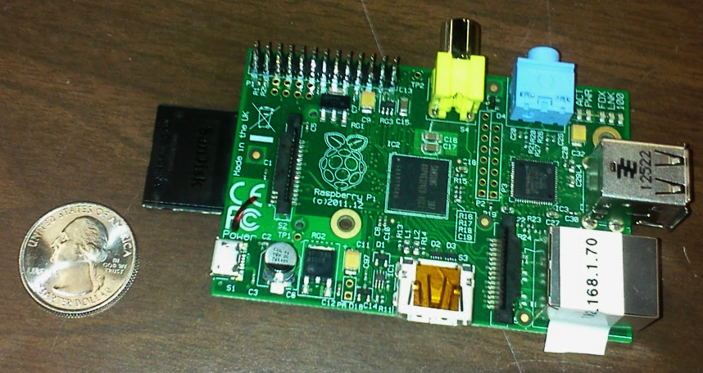
Raspberry Pi
700 MHz ARMv6 ISA
8 GPIO
Smallest physical footprint

Slide 21
Operating System
Raspbian Debian linux operating system tailored for raspberry Pi
Threaded Application
Onboard development
Libraries

Slide 22
Communication
TCP Communication
Custom Communication Protocol
Packet Section | # Bytes
Initialization | 2
Action Code | 3
Packet Data | N
Command Name | Command Type | Action Code
Start | System | 0xA01
GetDepthImage | Image | 0xCD1

Slide 23
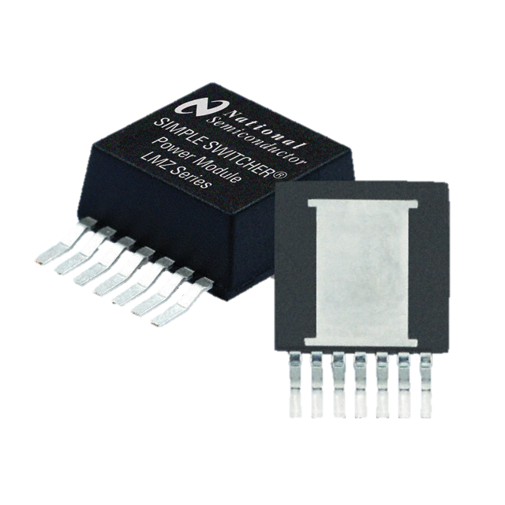
Power
Source: 12VDC
Output: 5VDC and 12VDC
Part: TI LMZ14203 Switching Module
Source Input: 6V - 42V
Max Output: 18 Watts
Output Voltage: 0.8V - 6V

Slide 24
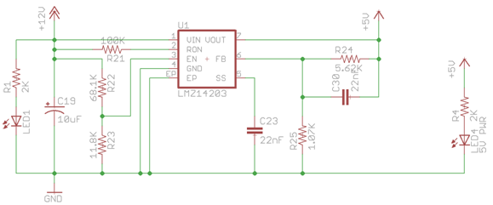
Power
LMZ14203 Switching Module

Slide 25
Testing
Software Testing
Laser
Motor
Microcontroller
3D Scan Testing
Indoor/Outdoor
Day/Night
Movement

Slide 26
Division of Labor
 | Andrew | Christian | Jon
Laser | X
Motor | X |  | X
Mount | X
Communication |  | X | X
Power |  | X | X
Visualization |  | X
Testing | X | X | X

Slide 27
Budget
Raspberry Pi model B | $35
Hokuyo UTM-30LX | $5,999
Dynamixel MX-28 | $219
Logitech Business Pro 9000 | $65
Mercotac Rotating Connector 830 | $449
PCB | $50
FTDI Chip USB-RS485-WE-5000-BT | $45
Power System | $150
Total Cost | $7,015
TI & UCF Robotics Club Donated Parts | -$7,015
Final Cost | $0

Slide 28
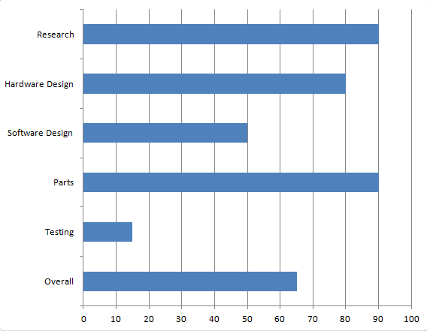
Progress

Slide 29
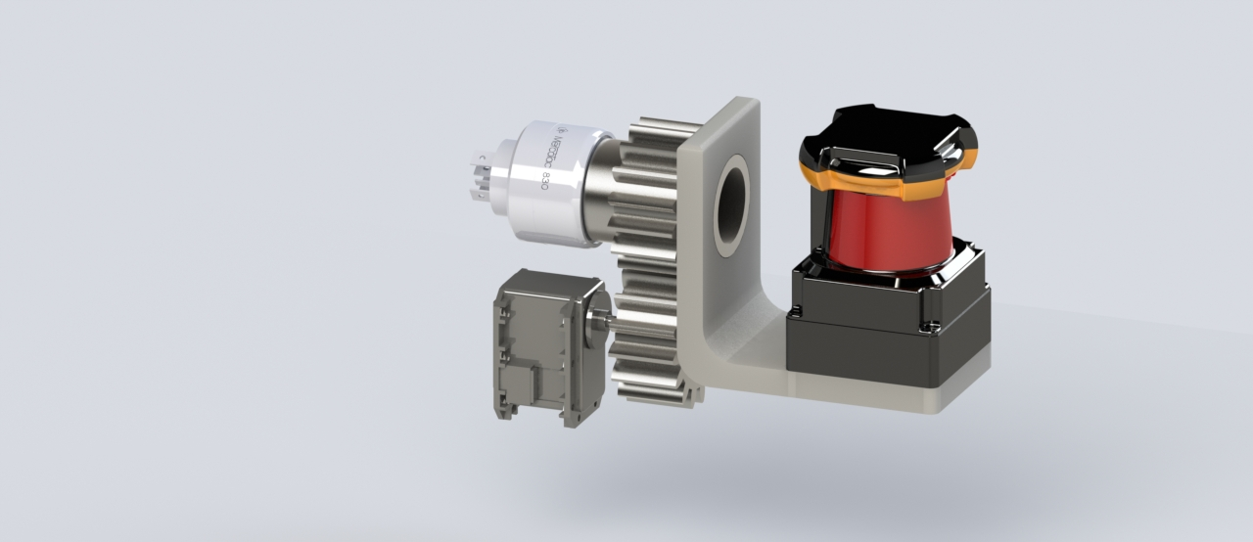
Project Status

Slide 30
Difficulties
Event Timing
Rotating Platform
Real Time Rendering
Vehicle Movement

Slide 31
Questions?

